Slide 1

SIDDAGANGA INSTITUTE OF TECHNOLOGY, TUMAKURU (An Autonomous institution affiliated to Visvesvaraya Technological University- Belagavi)
“ DIGITAL ELECTRONICS CIRCUIT AND VERILOG” BACHELOR OF ENGINEERING IN ELECTRONICS AND COMMUNICATION ENGINEERING.
“DIGITAL CALCULATOR USING ARDUINO UNO”
Submitted by: Submitted to:
PRUTHVIRAJ S YALI (1SI23EC086) Dr. S. Mala
SUSHANTH K S (1SI23EC117) Assistant Professor , Dept of ECE.
SRINIVASA G (1SI23EC110) Academic year 2024-2025
KIRAN G T(1SI24EC405)
MAHAMMAD AWAIZ(1SI24EC406)

Slide 2
Objective: The objective of this project is to design and build a digital calculator that can perform basic arithmetic operations such as addition, subtraction, multiplication, and division using Arduino microcontroller. -Perform basic arithmetic operations. -Use Arduino microcontroller. -Interactive and user-friendly.

Slide 3
Components: The following components are used in this project: -Arduino Board (e.g. Arduino Uno). -4x4 Keypad. -16x2 LCD Display. -Jumper Wires. -Power Source (9V). -I2C module.

Slide 4
Circuit Diagram The circuit diagram for this project is as Shown: The 4x4 keypad is connected to the Arduino board as follows: - Row 1: Pin 2 -Column 1:Pin 6 - Row 2: Pin 3 - Column 2: Pin 7 - Row 3: Pin 4 - Column 3: Pin 8 - Row 4: Pin 5 - Column 4: Pin 9 The 16x2 LCD display is connected to the Arduino board as follows: - RS: Pin 10 - E: Pin 11 - D4: Pin 12 - D5: Pin 13 - D6: Pin A0 - D7: Pin A1

Slide 5
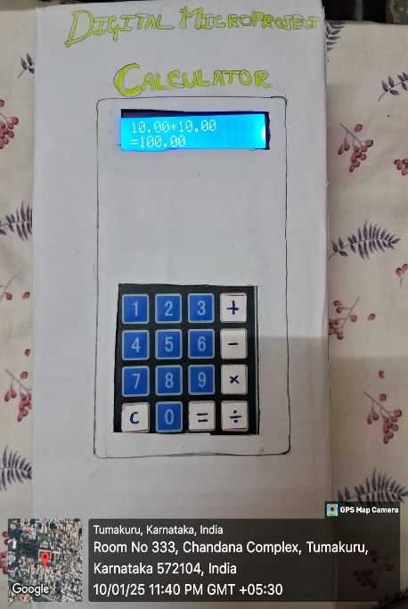
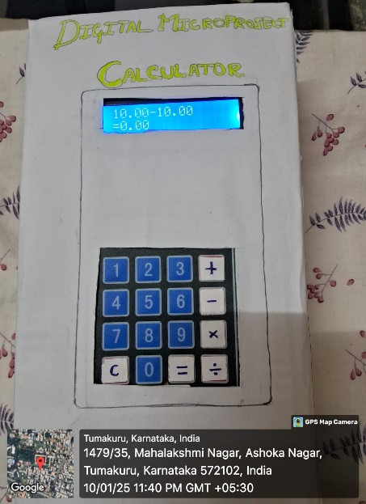
Results:

Slide 6


